Slide 1
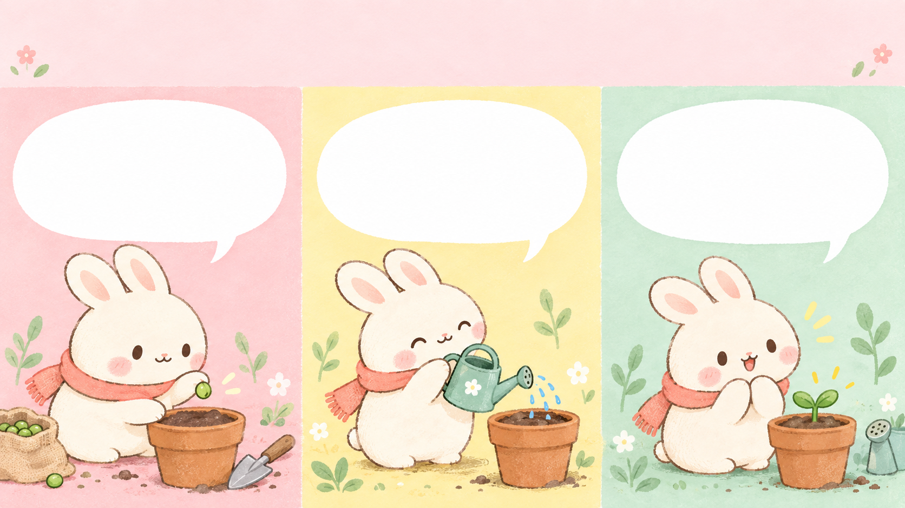
A tiny garden adventure
One little seed.
A little water.
A little patience.
Notes:
Cute comic: Story sequence. Fictional showcase content. Planned actions and numerical examples are illustrative, not real results or official claims. Generated artwork is conceptual. All text is editable.
A tiny garden adventure
One little seed.
A little water.
A little patience.

Slide 2

What does a seed need?
Water • Air • Warmth
Once it sprouts, give it light.
Notes:
Cute comic: Question and discovery. Fictional showcase content. Planned actions and numerical examples are illustrative, not real results or official claims. Generated artwork is conceptual. All text is editable.
What does a seed need?
Water • Air • Warmth
Once it sprouts, give it light.

Slide 3
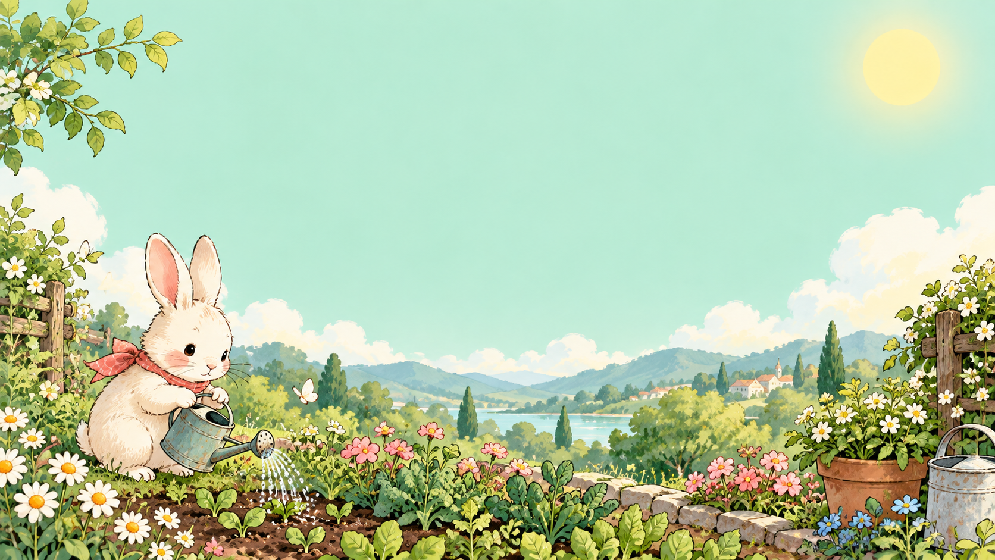
Small steps.
Something grows.
Try growing one seed this week.
Notes:
Cute comic: Closing scene. Fictional showcase content. Planned actions and numerical examples are illustrative, not real results or official claims. Generated artwork is conceptual. All text is editable.
Small steps. Something grows.
Try growing one seed this week.

