Slide 1
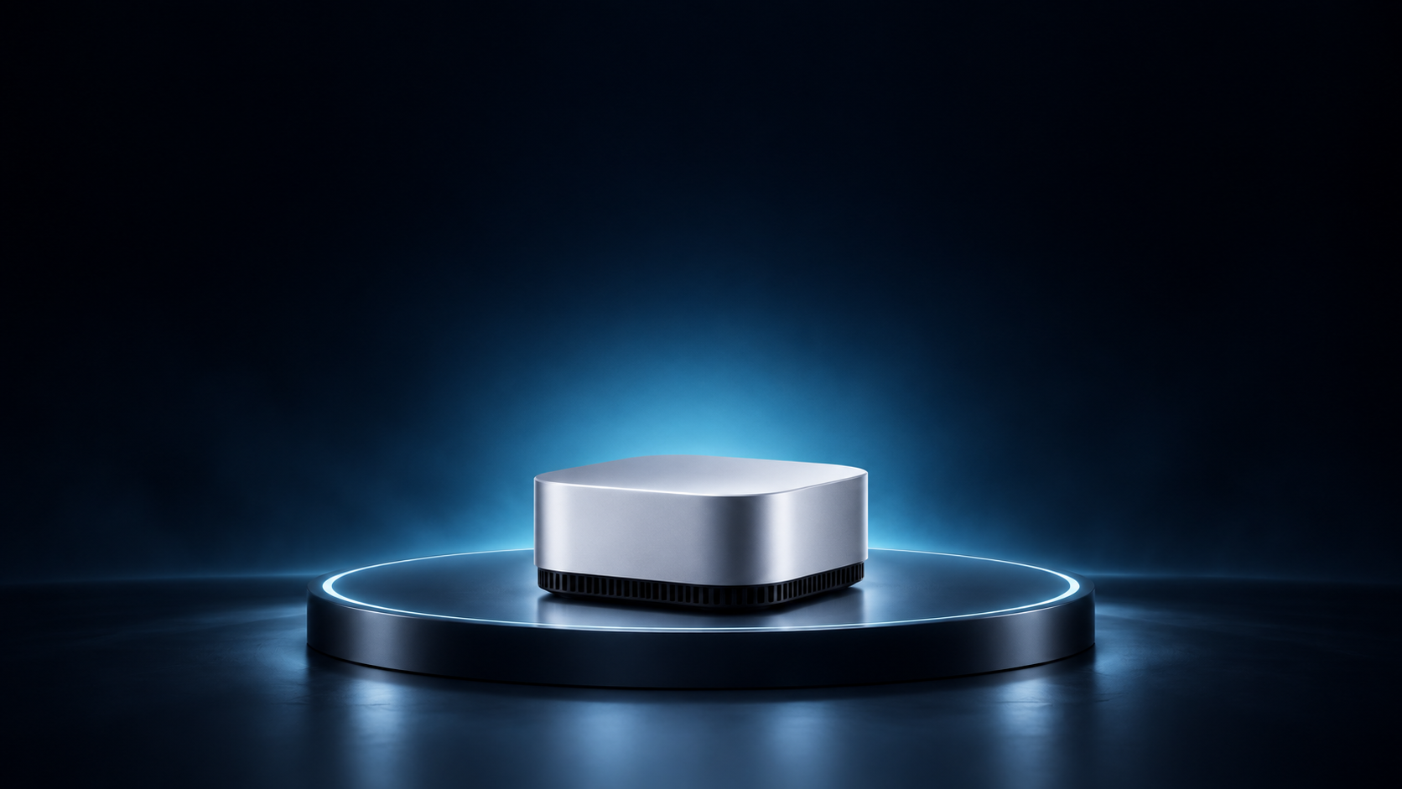
Meet the quiet core
A concept for a calmer desktop
Notes:
Technology launch: Reveal moment. Fictional showcase content. Planned actions and numerical examples are illustrative, not real results or official claims. Generated artwork is conceptual. All text is editable.
Meet the quiet core
A concept for a calmer desktop

Slide 2
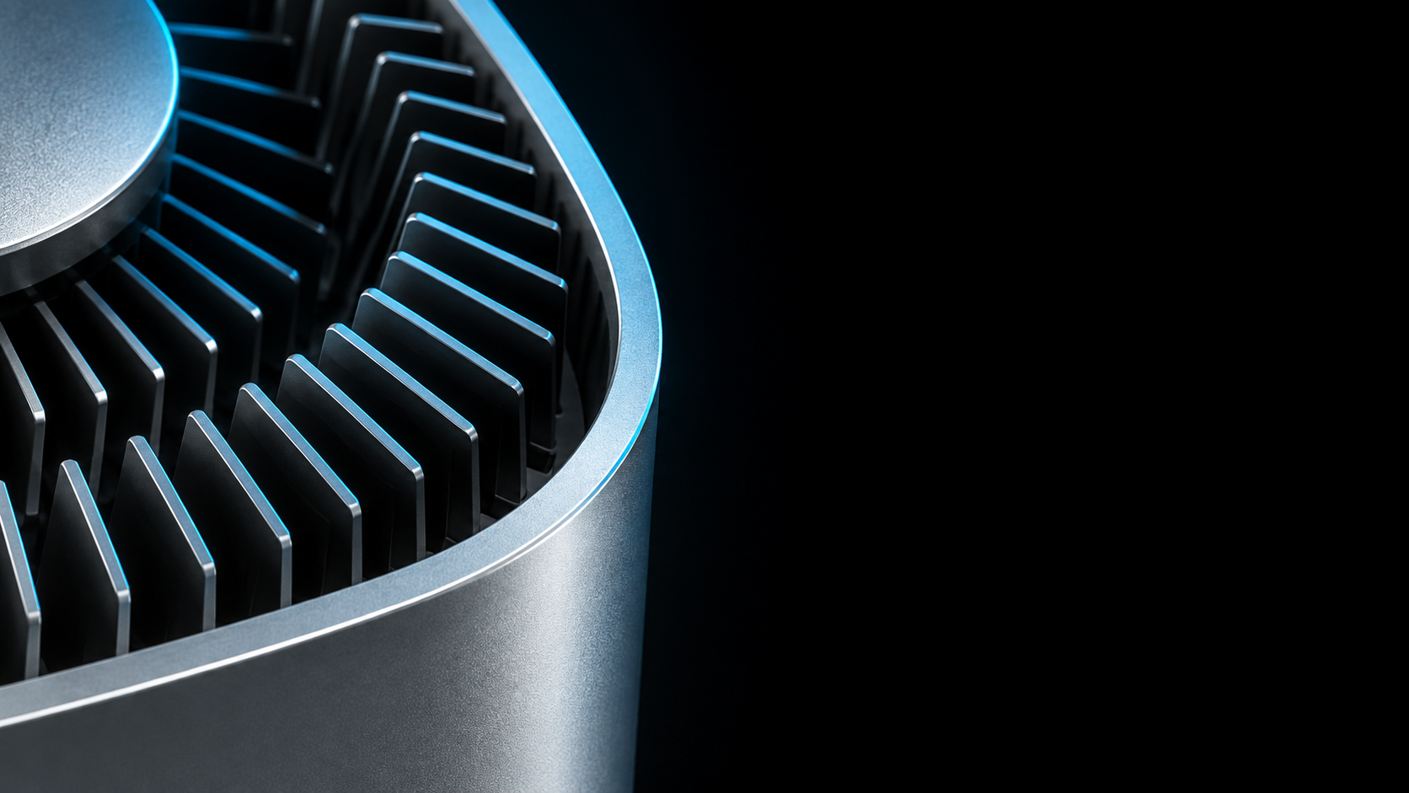
Designed around
airflow
A clear path through the chassis
Concept direction:
accessible vents and a
serviceable outer shell
Notes:
Technology launch: Hardware detail. Fictional showcase content. Planned actions and numerical examples are illustrative, not real results or official claims. Generated artwork is conceptual. All text is editable.
Designed around airflow
A clear path through the chassis
Concept direction: accessible vents and a serviceable outer shell

Slide 3
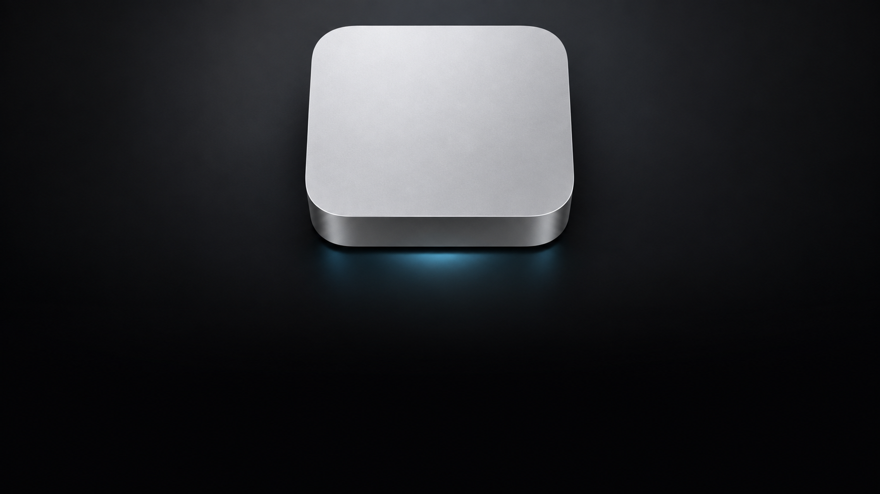
Small by
design
COMPACT
SERVICEABLE
CONCEPT
Desk-friendly
footprint
Removable
outer shell
Not a shipping
product
Notes:
Technology launch: Design specification. Fictional showcase content. Planned actions and numerical examples are illustrative, not real results or official claims. Generated artwork is conceptual. All text is editable.
Small by design
COMPACT
Desk-friendly footprint
SERVICEABLE
Removable outer shell
CONCEPT
Not a shipping product

